Slide 1
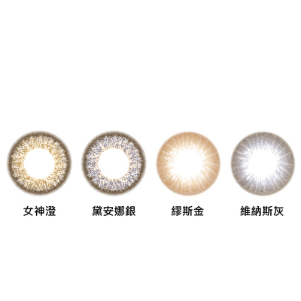
春日部防衛隊
CV'22 FINAL [Pupil Tracking] By GANZIN
傅立威
r10942078
陳姍苓
r10942089
駱皓正
d08227104
陳奕舟
r10942061

Slide 2
Overview
Experiment settings
Rule-based approach
OpenCV
Learning-based approach
U-Net
Segformer
YOLO
Post-processing
Results
Discussion & Conclusion
Notes:
空空的地方可以放個影片 或是 留白也是種美~

Slide 3
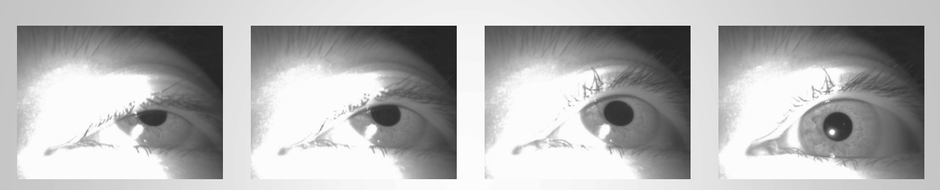
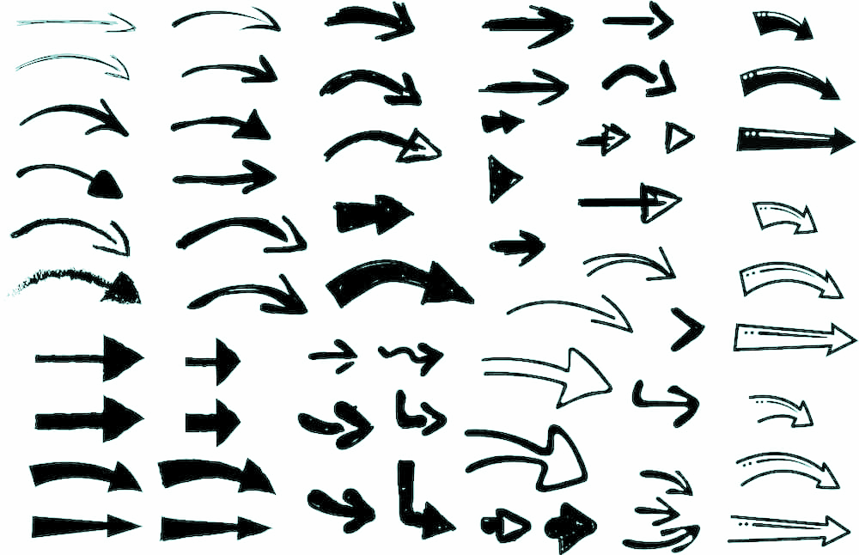
Experimental Settings
Rule-based
OpenCV
Exp #1
Learning-based
U-Net
Exp #2
Segformer
Exp #3
Semantic
Segmentation
YOLO
Exp #4
Exp #5
Ensemble
Unit
Post
Processing
Notes:
[實驗編號以後續表格為主]

Slide 4
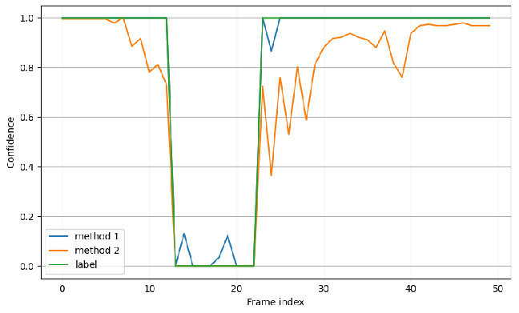
Experimental Settings
YES
ResNet
.
.
.
NO
Confidence
Prediction
Image Classification

Slide 5
Conventional
CV

Slide 6
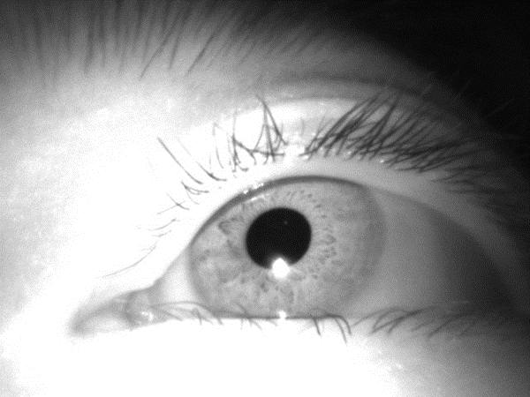
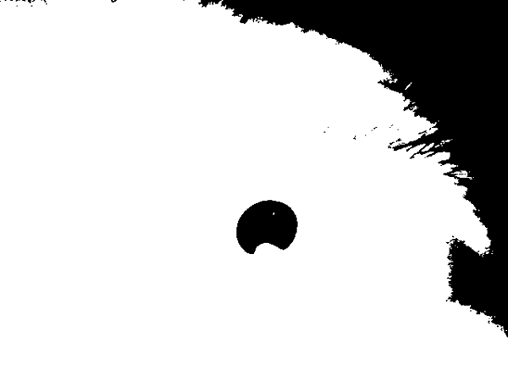

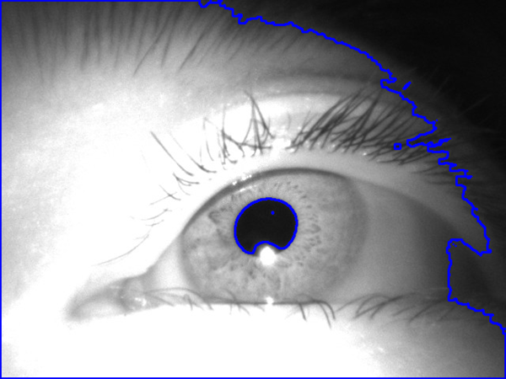
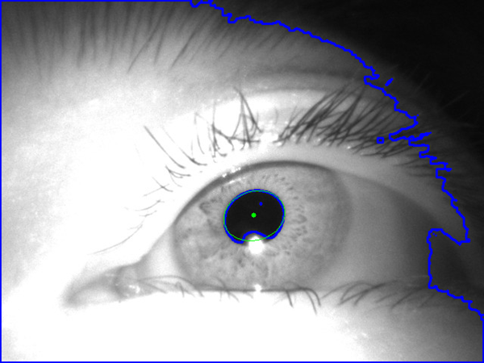
Original Input
Binary Threshold
Closing Denoise
circularity = circumference ** 2 / (4 * math.pi * area)
Compute contour circularity
Fit Ellipse (circularity < 1.5)
Notes:
Morphology 形態學
Closing 閉運算 = 先做 Dilation 再做 Erosion
maybe可以畫個pipeline~~

Slide 7
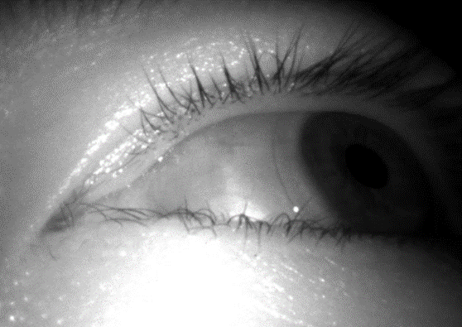
Conventional CV Shortcomings:
Difficulty obtaining contours from darker images
The thresholds vary from images to images
Notes:
1. CV不擅長抓整體太暗的圖 輪廓會抓不到或抓不好
2. thresholded選多少是個問題，不同圖片適合的thresholded不一樣
3. 可能直接抓到整個眼球

Slide 8
U-Net

Slide 9
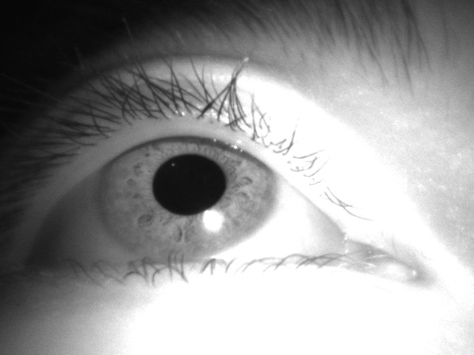
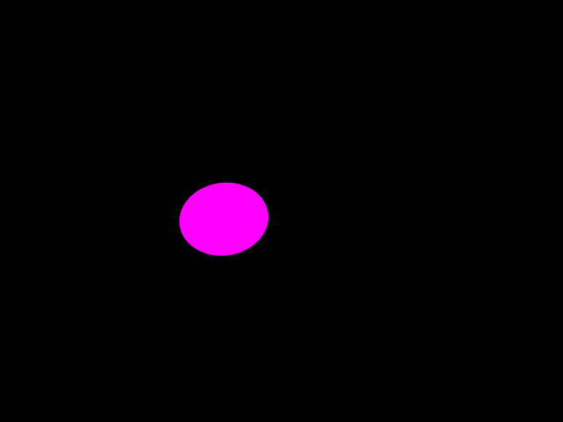
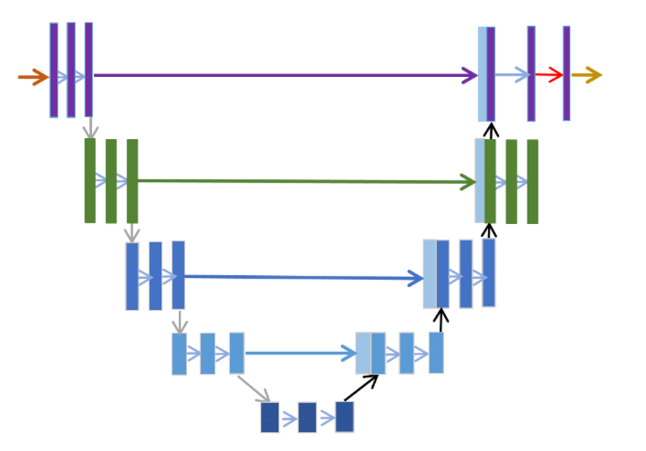
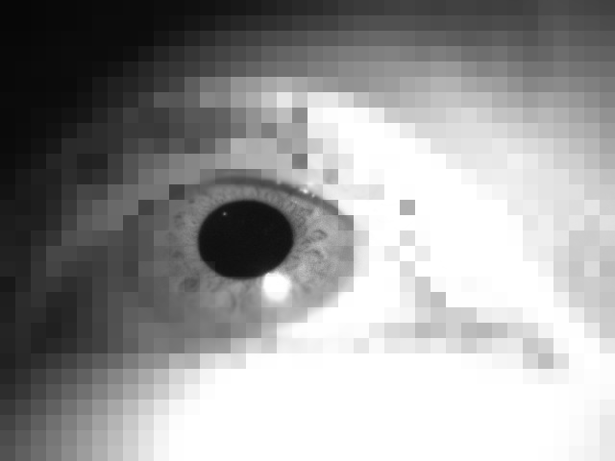

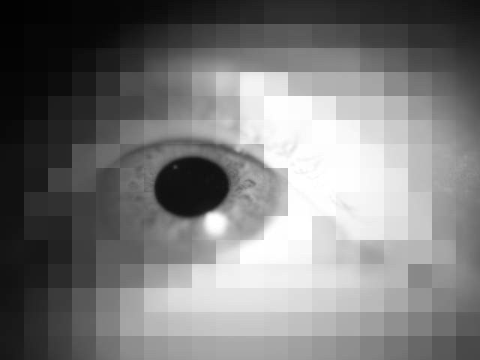

U-Net
Encoder
Decoder

Slide 10
Model Training Techniques
Data Augmentation (brightness, contrast, crop, flip)
Scheduler
Pretrained weight
Delete unlabeled images
Self-supervised learning

Slide 11

Self-supervised learning

Slide 12
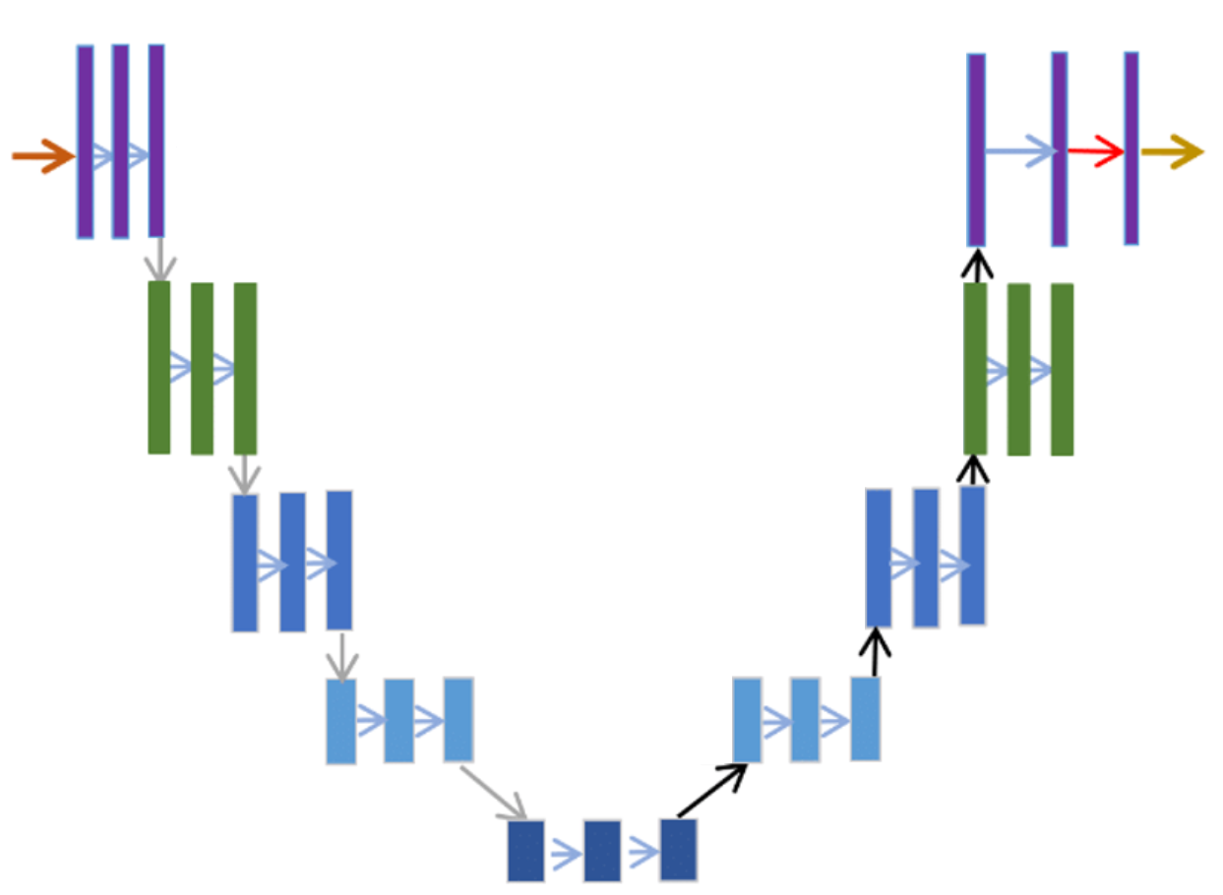
Self-supervised learning

Slide 13
Segformer

Slide 14
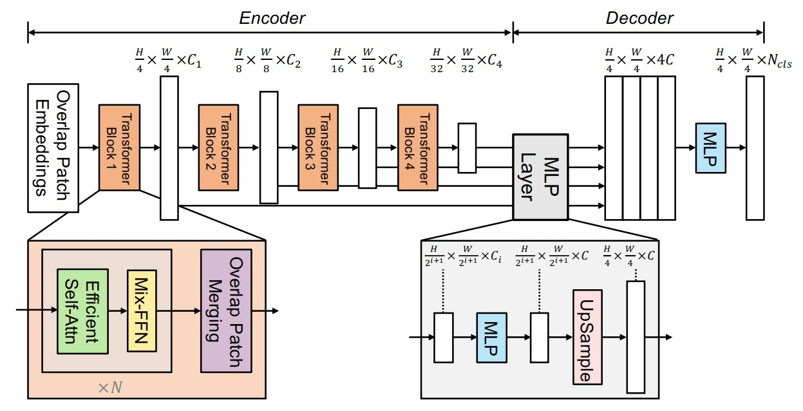
Segformer
Notes:
Segformer是利用分層式的transformer當作encoder，來輸出不同大小尺度的特徵資訊
再利用輕量化的MLP decoder來聚合不同層的特徵訊息，從而結合局部資訊和整體資訊

Slide 15
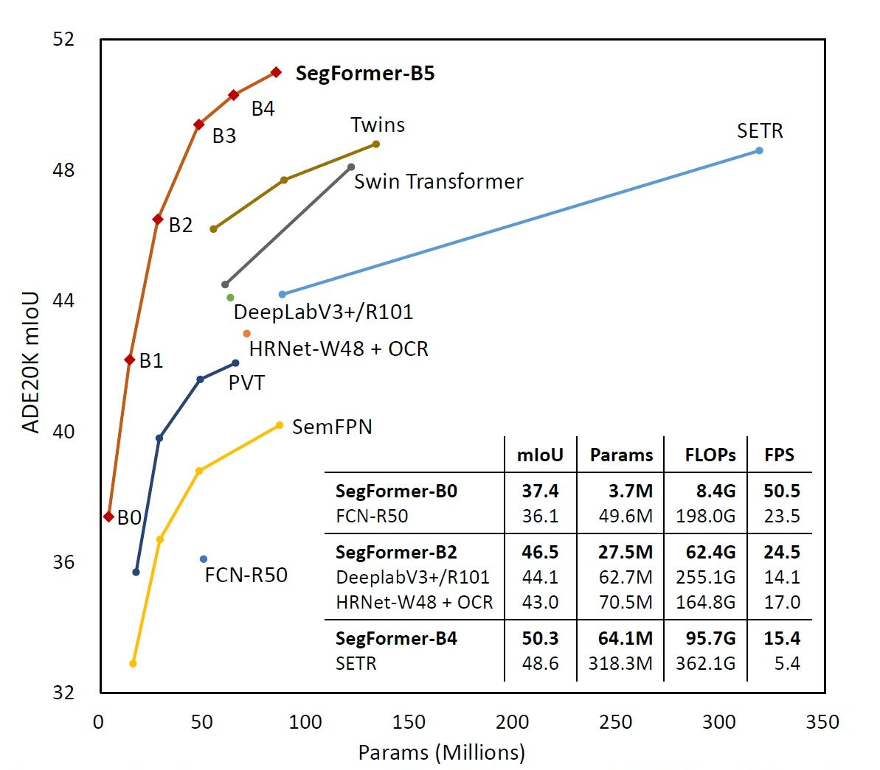
Segformer
Notes:
這張圖是segformer和其他model在同一個dataset的segmentation performance比較圖
segformer根據model大小不同 分成B0~5
經過測試，比較採用B3~5 pretrained model的訓練結果，我們發現B4在這個final的dataset表現的最好，因此我們是使用B4 model

Slide 16
YOLO

Slide 17
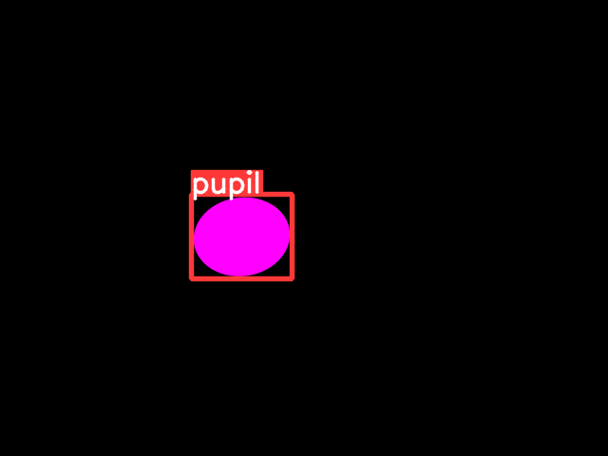
Object detection model
Create object bounding boxes from the pupil labels as the groundtruths
Notes:
yolo note
yolo框得非常好
很多segmentation model偵測不出來的yolo都框的出來

Slide 18
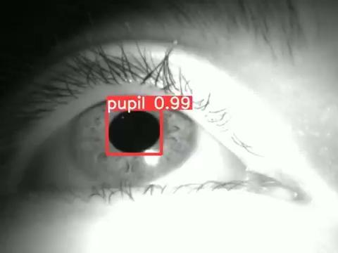

Slide 19
Postprocessing

Slide 20
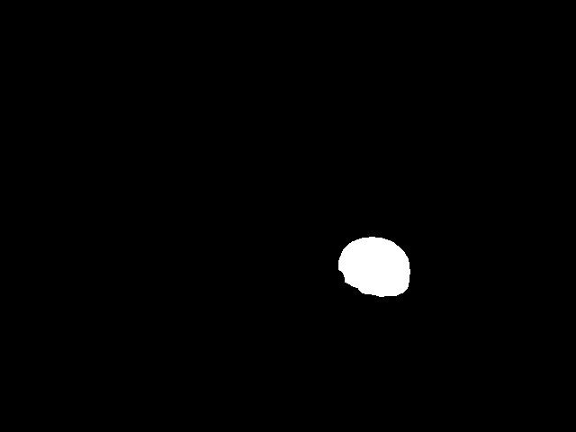
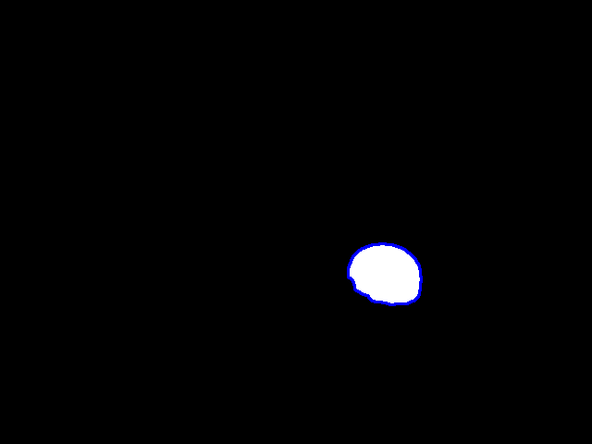
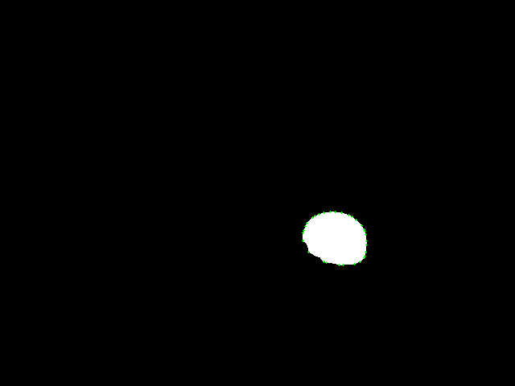

Orginal Segmented Mask
Find Contour
Find Convex Hull
Fit Ellipse

Slide 21
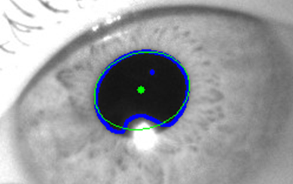
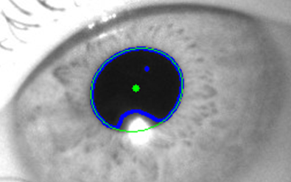
Improve ellipse fitting by finding the convex hull of the contour

Slide 22

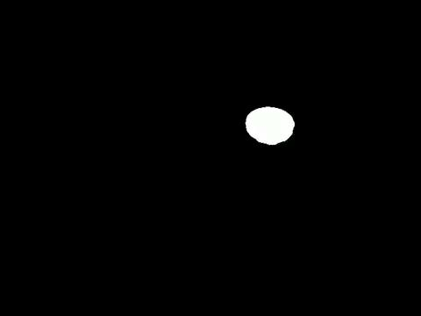
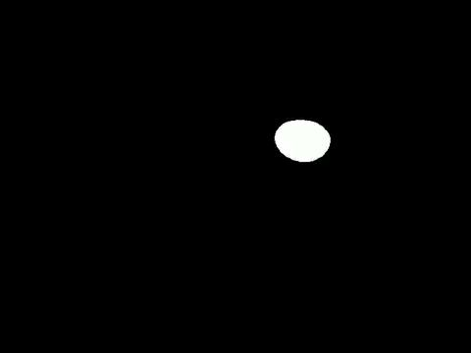


Segformer result 1
Segformer result 2
Refined Mask
Fit Ellipse
(Output)
Unet result
Fit Ellipse
Ensemble Unit

Slide 23
Results

Slide 24
S5 testing result
Seg. model | IoU
Conventional CV (#1) | 0.3884
Unet (#2) | 0.9492
Segformer (#3) | 0.9455/0.9591
YOLO (#4) | 0.8102
Ensemble (#5) | 0.9540
Conf. model | TNR
Resnet | 0.9611
Ensemble | 0.9674
YOLO | 0.8104
YOLO conf=0.3
Notes:
yolo conf=0.3

Slide 25
Discussion & Conclusion

Slide 26
We combined and experimented with the Segformer, Unet and YOLO network model to segment the pupil.
We also trained a classification model to obtain the prediction confidence.
By fitting the segmented areas to an ellipse, we get the refined pupil masks.

Slide 27
Reference
[1] Xie, Enze, et al. "SegFormer: Simple and efficient design for semantic segmentation with transformers." Advances in Neural Information Processing Systems 34 (2021): 12077-12090.
[2] Ronneberger, Olaf, Philipp Fischer, and Thomas Brox. "U-net: Convolutional networks for biomedical image segmentation." International Conference on Medical image computing and computer-assisted intervention. Springer, Cham, 2015.
[3] Bochkovskiy, Alexey, Chien-Yao Wang, and Hong-Yuan Mark Liao. "Yolov4: Optimal speed and accuracy of object detection." arXiv preprint arXiv:2004.10934 (2020).

Slide 28

傅立威
r10942078
陳姍苓
r10942089
駱皓正
d08227104
陳奕舟
r10942061

